Slide 1
Power Iteration Clustering
Frank Lin and William W. Cohen
School of Computer Science, Carnegie Mellon University
ICML 2010
2010-06-23, Haifa, Israel

Slide 2
Overview
Preview
Motivation
Power Iteration Clustering
  Power Iteration
  Stopping
Results
Related Work

Slide 3
Overview
Preview
Motivation
Power Iteration Clustering
  Power Iteration
  Stopping
Results
Related Work

Slide 4
Preview
Spectral clustering methods are nice

Slide 5
Preview
Spectral clustering methods are nice
But they are rather expensive (slow)

Slide 6
Preview
Spectral clustering methods are nice
But they are rather expensive (slow)
Power iteration clustering can provide a similar solution at a very low cost (fast)

Slide 7
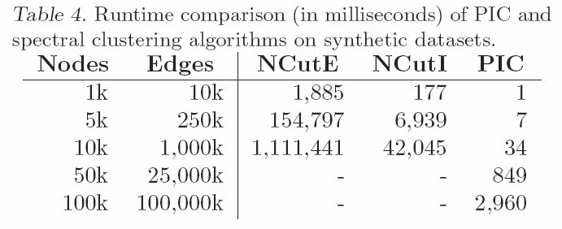
Preview: Runtime

Slide 8
Preview: Runtime
Normalized Cut

Slide 9
Preview: Runtime
Normalized Cut
Normalized Cut, faster implementation

Slide 10
Preview: Runtime
Normalized Cut
Normalized Cut, faster implementation
Pretty fast

Slide 11
Preview: Runtime
Normalized Cut
Normalized Cut, faster implementation
Ran out of memory (24GB)

Slide 12
Preview: Accuracy

Slide 13
Preview: Accuracy
Upper triangle: PIC does better

Slide 14
Preview: Accuracy
Upper triangle: PIC does better
Lower triangle: NCut or NJW does better

Slide 15
Overview
Preview
Motivation
Power Iteration Clustering
  Power Iteration
  Stopping
Results
Related Work

Slide 16
k-means
A well-known clustering method

Slide 17
k-means
A well-known clustering method
3-cluster examples:

Slide 18
k-means
A well-known clustering method
3-cluster examples:
☺

Slide 19
k-means
A well-known clustering method
3-cluster examples:
☺
☹
☹

Slide 20
Spectral Clustering
Instead of clustering data points in their original (Euclidean) space, cluster them in the space spanned by the “significant” eigenvectors of an (Laplacian) affinity matrix

Slide 21
Spectral Clustering
Instead of clustering data points in their original (Euclidean) space, cluster them in the space spanned by the “significant” eigenvectors of an (Laplacian) affinity matrix
Affinity matrix: a matrix A where A_{ij} is the similarity between data points i and j.

Slide 22
Spectral Clustering
Network = Graph = Matrix
 | A | B | C | D | E | F | G | H | I | J
A |  | 1 |  | 1 |  | 1
B | 1 |  | 1
C |  | 1
D | 1 |  |  |  |  | 1
E |  |  |  |  |  | 1
F | 1 |  |  | 1 | 1
G |  |  |  |  |  |  |  |  | 1
H |  |  |  |  |  |  |  |  | 1 | 1
I |  |  |  |  |  |  | 1 | 1 |  | 1
J |  |  |  |  |  |  |  | 1 | 1
C
A
B
G
I
H
J
F
D
E

Slide 23
Spectral Clustering
Results with Normalized Cuts:
☺
☺
☺

Slide 24
Spectral Clustering
dataset and normalized cut results
2nd eigenvector
3rd eigenvector

Slide 25
Spectral Clustering
dataset and normalized cut results
cluster
1
2
3
2nd eigenvector
value
index
3rd eigenvector

Slide 26
Spectral Clustering
dataset and normalized cut results
cluster
1
2
3
clustering space
2nd smallest eigenvector
value
index
3rd smallest eigenvector

Slide 27
Spectral Clustering
A typical spectral clustering algorithm:
  Choose k and similarity function s
  Derive affinity matrix A from s, transform A to a (normalized) Laplacian matrix W
  Find eigenvectors and corresponding eigenvalues of W
  Pick the k eigenvectors of W with the smallest corresponding eigenvalues as “significant” eigenvectors
  Project the data points onto the space spanned by these vectors
  Run k-means on the projected data points

Slide 28
Spectral Clustering
Normalized Cut algorithm (Shi & Malik 2000):
  Choose k and similarity function s
  Derive A from s, let W=I-D⁻¹A, where I is the identity matrix and D is a diagonal square matrix D_{ii}=Σ_{j} A_{ij}
  Find eigenvectors and corresponding eigenvalues of W
  Pick the k eigenvectors of W with the 2nd to k^{th} smallest corresponding eigenvalues as “significant” eigenvectors
  Project the data points onto the space spanned by these vectors
  Run k-means on the projected data points

Slide 29
Spectral Clustering
Finding eigenvectors and eigenvalues of a matrix is very slow in general: O(n³)
Normalized Cut algorithm (Shi & Malik 2000):
  Choose k and similarity function s
  Derive A from s, let W=I-D⁻¹A, where I is the identity matrix and D is a diagonal square matrix D_{ii}=Σ_{j} A_{ij}
  Find eigenvectors and corresponding eigenvalues of W
  Pick the k eigenvectors of W with the 2nd to k^{th} smallest corresponding eigenvalues as “significant” eigenvectors
  Project the data points onto the space spanned by these vectors
  Run k-means on the projected data points

Slide 30
Hmm…
Can we find a low-dimensional embedding for clustering, as spectral clustering, but without calculating these eigenvectors?

Slide 31
Overview
Preview
Motivation
Power Iteration Clustering
  Power Iteration
  Stopping
Results
Related Work

Slide 32
The Power Iteration
Or the power method, is a simple iterative method for finding the dominant eigenvector of a matrix:
W – a square matrix
v^{t} – the vector at iteration t; v⁰ is typically a random vector
c – a normalizing constant to avoid v^{t} from getting too large or too small
Typically converges quickly, and is fairly efficient if W is a sparse matrix

Slide 33
The Power Iteration
Or the power method, is a simple iterative method for finding the dominant eigenvector of a matrix:
What if we let W=D⁻¹A (similar to Normalized Cut)?

Slide 34
The Power Iteration
Or the power method, is a simple iterative method for finding the dominant eigenvector of a matrix:
What if we let W=D⁻¹A (similar to Normalized Cut)?
The short answer is that it converges to a constant vector, because the dominant eigenvector of a row-normalized matrix is always a constant vector

Slide 35
The Power Iteration
Or the power method, is a simple iterative method for finding the dominant eigenvector of a matrix:
What if we let W=D⁻¹A (similar to Normalized Cut)?
The short answer is that it converges to a constant vector, because the dominant eigenvector of a row-normalized matrix is always a constant vector
Not very interesting. However…

Slide 36
Power Iteration Clustering
It turns out that, if there is some underlying cluster in the data, PI will quickly converge locally within clusters then slowly converge globally to a constant vector.
The locally converged vector, which is a linear combination of the top eigenvectors, will be nearly piece-wise constant with each piece corresponding to a cluster

Slide 37
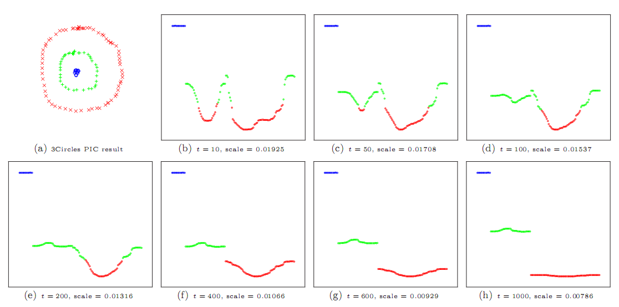
Power Iteration Clustering

Slide 38
Power Iteration Clustering
colors correspond to what k-means would “think” to be clusters in this one-dimension embedding
larger
smaller

Slide 39
Power Iteration Clustering
Recall the power iteration update:

Slide 40
Power Iteration Clustering
Recall the power iteration update:
e_{i} – the eigenvector corresponding to λ_{i}
c_{i} - the i^{th} coefficient of v when projected onto the space spanned by the eigenvectors of W
λ_{i} - the i^{th} largest eigenvalue of W

Slide 41
Power Iteration Clustering
Group the c_{i}λ_{i}e_{i} terms, and define pic^{t}(a,b) to be the absolute difference between elements in the v^{t}, where a and b corresponds to indices a and b on v^{t}:

Slide 42
Power Iteration Clustering
Group the c_{i}λ_{i}e_{i} terms, and define pic^{t}(a,b) to be the absolute difference between elements in the v^{t}, where a and b corresponds to indices a and b on v^{t}:
The first term is 0 because the first (dominant) eigenvector is a constant vector

Slide 43
Power Iteration Clustering
Group the c_{i}λ_{i}e_{i} terms, and define pic^{t}(a,b) to be the absolute difference between elements in the v^{t}, where a and b corresponds to indices a and b on v^{t}:
The first term is 0 because the first (dominant) eigenvector is a constant vector
As t gets bigger, the last term goes to 0 quickly

Slide 44
Power Iteration Clustering
Group the c_{i}λ_{i}e_{i} terms, and define pic^{t}(a,b) to be the absolute difference between elements in the v^{t}, where a and b corresponds to indices a and b on v^{t}:
The first term is 0 because the first (dominant) eigenvector is a constant vector
We are left with the term that “signals” the cluster corresponding to eigenvectors!
As t gets bigger, the last term goes to 0 quickly

Slide 45
Power Iteration Clustering
The 2nd to k^{th} eigenvectors of W=D⁻¹A are roughly piece-wise constant with respect to the underlying clusters, each separating a cluster from the rest of the data (Meila & Shi 2001)

Slide 46
Power Iteration Clustering
The 2nd to k^{th} eigenvectors of W=D⁻¹A are roughly piece-wise constant with respect to the underlying clusters, each separating a cluster from the rest of the data (Meila & Shi 2001)
The linear combination of piece-wise constant vectors is also piece-wise constant!

Slide 47
Spectral Clustering
dataset and normalized cut results
cluster
1
2
3
clustering space
2nd smallest eigenvector
value
index
3rd smallest eigenvector

Slide 48
Spectral Clustering
dataset and normalized cut results
clustering space
2nd smallest eigenvector
value
index
3rd smallest eigenvector

Slide 49
Spectral Clustering
2nd smallest eigenvector
3rd smallest eigenvector

Slide 51
a·
+
b·

Slide 52
a·
+
b·
=

Slide 53
a·
+
b·
=

Slide 54
Power Iteration Clustering

Slide 55
Power Iteration Clustering
dataset and PIC results
v^{t}

Slide 56
Power Iteration Clustering
The Take-Away
To do clustering, we may not need all the information in a spectral embedding (e.g., distance between clusters in a k-dimension eigenspace); we just need the clusters to be separated in some space.
dataset and PIC results
v^{t}

Slide 57
Power Iteration Clustering
dataset and PIC results
v^{t}
t=?

Slide 58
Power Iteration Clustering
dataset and PIC results
v^{t}
t=?
Want to iterate enough to show clusters, but not too much so as to converge to a constant vector

Slide 59
Overview
Preview
Motivation
Power Iteration Clustering
  Power Iteration
  Stopping
Results
Related Work

Slide 60
When to Stop
Recall:

Slide 61
When to Stop
Recall:
Then:

Slide 62
When to Stop
Recall:
Then:
Because they are raised to the power t, the eigenvalue ratios determines how fast v converges to e₁

Slide 63
When to Stop
Recall:
At the beginning, v changes fast (“accelerating”) to converge locally due to “noise terms” (k+1…n) with small λ
Then:
Because they are raised to the power t, the eigenvalue ratios determines how fast v converges to e₁

Slide 64
When to Stop
Recall:
At the beginning, v changes fast (“accelerating”) to converge locally due to “noise terms” (k+1…n) with small λ
Then:
When “noise terms” have gone to zero, v changes slowly (“constant speed”) because only larger λ terms (2…k) are left, where the eigenvalue ratios are close to 1
Because they are raised to the power t, the eigenvalue ratios determines how fast v converges to e₁

Slide 65
When to Stop
So we can stop when the “acceleration” is nearly zero.

Slide 66
When to Stop
Power iteration convergence depends on this term (could be very slow)
Recall:
Then:

Slide 67
When to Stop
Power iteration convergence depends on this term (could be very slow)
PIC convergence depends on this term (always fast)
Recall:
Then:

Slide 68
Algorithm
A basic power iteration clustering algorithm:
Input: A row-normalized affinity matrix W and the number of clusters k
Output: Clusters C₁, C₂, …, C_{k}
Pick an initial vector v⁰
Repeat
  Set v^{t+1} ← Wv^{t}
  Set δ^{t+1} ← |v^{t+1} – v^{t}|
  Increment t
  Stop when |δ^{t} – δ^{t-1}| ≈ 0
Use k-means to cluster points on v^{t} and return clusters C₁, C₂, …, C_{k}

Slide 69
Overview
Preview
Motivation
Power Iteration Clustering
  Power Iteration
  Stopping
Results
Related Work

Slide 70
Results on Real Data
“Network” problems - natural graph structure:
  PolBooks 105 political books, 3 classes, linked by co-purchaser
  UMBCBlog 404 political blogs, 2 classes, blog post links
  AGBlog 1222 political blogs, 2 classes, blogroll links
“Manifold” problems - cosine distance between instances:
  Iris 150 flowers, 3 classes
  PenDigits01 200 handwritten digits, 2 classes (“0” and “1”)
  PenDigits17 200 handwritten digits, 2 classes (“1” and “7”)
  20ngA 200 docs, misc.forsale vs. soc.religion.christian
  20ngB 400 docs, misc.forsale vs. soc.religion.christian
  20ngC 20ngB + 200 docs from talk.politics.guns
  20ngD 20ngC + 200 docs from rec.sport.baseball

Slide 71
Accuracy Results
Upper triangle: PIC does better
Lower triangle: NCut or NJW does better

Slide 72
Accuracy Results

Slide 73
Accuracy Results

Slide 74
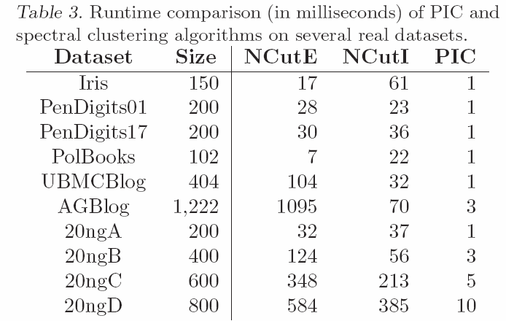
Runtime Speed Results

Slide 75
Runtime Speed Results
Normalized Cut using Eigenvalue Decomposition

Slide 76
Runtime Speed Results
Normalized Cut using Eigenvalue Decomposition
Normalized Cut using the Implicitly Restarted Arnoldi Method

Slide 77
Runtime Speed Results
Some of these ran in less than a millisecond

Slide 78
Runtime Speed Results

Slide 79
Runtime Speed Results
Modified version of Erdos-Renyi with two similar-sized cluster per dataset

Slide 80
Runtime Speed Results
Ran out of memory (24GB)

Slide 81
Overview
Preview
Motivation
Power Iteration Clustering
  Power Iteration
  Stopping
Results
Related Work

Slide 82
Related Clustering Work
Spectral Clustering
  (Roxborough & Sen 1997, Shi & Malik 2000, Meila & Shi 2001, Ng et al. 2002)
Kernel k-Means (Dhillon et al. 2007)
Modularity Clustering (Newman 2006)
Matrix Powering
  Markovian relaxation & the information bottleneck method (Tishby & Slonim 2000)
  matrix powering (Zhou & Woodruff 2004)
  diffusion maps (Lafon & Lee 2006)
  Gaussian blurring mean-shift (Carreira-Perpinan 2006)
Mean-Shift Clustering
  mean-shift (Fukunaga & Hostetler 1975, Cheng 1995, Comaniciu & Meer 2002)
  Gaussian blurring mean-shift (Carreira-Perpinan 2006)

Slide 83
Some “Powering” Methods at a Glance
Method | W | Iterate | Stopping | Final
Tishby & Slonim 2000 | W=D⁻¹A | W^{t+1}=W^{t} | rate of information loss | information bottleneck method
Zhou & Woodruff 2004 | W=A | W^{t+1}=W^{t} | a small t | a threshold ε
Carreira-Perpinan 2006 | W=D⁻¹A | X^{t+1}=WX | entropy | a threshold ε
PIC | W=D⁻¹A | v^{t+1}=Wv^{t} | acceleration | k-means

Slide 84
Some “Powering” Methods at a Glance
Method | W | Iterate | Stopping | Final
Tishby & Slonim 2000 | W=D⁻¹A | W^{t+1}=W^{t} | rate of information loss | information bottleneck method
Zhou & Woodruff 2004 | W=A | W^{t+1}=W^{t} | a small t | a threshold ε
Carreira-Perpinan 2006 | W=D⁻¹A | X^{t+1}=WX | entropy | a threshold ε
PIC | W=D⁻¹A | v^{t+1}=Wv^{t} | acceleration | k-means
How far can we go with a one- or low-dimensional embedding?

Slide 85
Conclusion
Fast
Space-efficient
Simple
Simple parallel/distributed implementation
Notes:
Ando & Lee – rescuing LSA ? SIGIR from 2005? Dealing with skew of sizes
Yoram and Deutche – Matt Streeter?
Method as a stochastic gradient?
Lanzos – from Shi – fast vision ncut methods
Negative starting values

Slide 86
Conclusion
Fast
Space-efficient
Simple
Simple parallel/distributed implementation
Plug: extensions for manifold problems with dense similarity matrices, without node/edge sampling (ECAI 2010)
Notes:
Ando & Lee – rescuing LSA ? SIGIR from 2005? Dealing with skew of sizes
Yoram and Deutche – Matt Streeter?
Method as a stochastic gradient?
Lanzos – from Shi – fast vision ncut methods
Negative starting values

Slide 87
Thanks to…
NIH/NIGMS
NSF
Microsoft LiveLabs
Google
Notes:
Ando & Lee – rescuing LSA ? SIGIR from 2005? Dealing with skew of sizes
Yoram and Deutche – Matt Streeter?
Method as a stochastic gradient?
Lanzos – from Shi – fast vision ncut methods
Negative starting values

Slide 88
Questions?

Slide 89
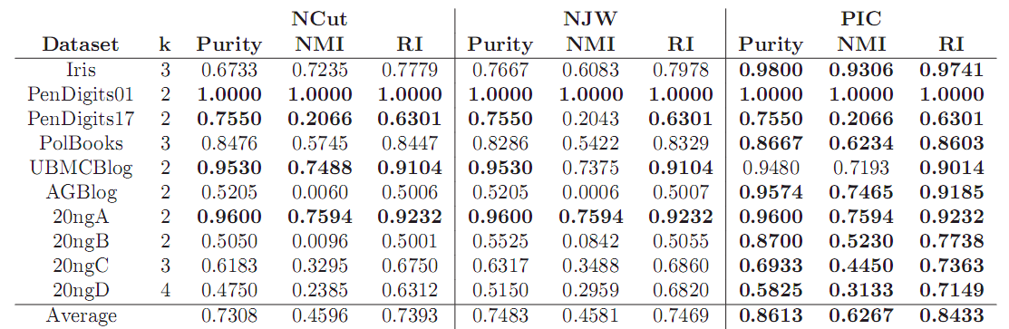
Accuracy Results

Slide 90
Accuracy Results
Methods compared: Normalized Cut, Ng-Jordan-Weiss, and PIC

Slide 91
Accuracy Results
Evaluation measures: Purity, Normalized Mutual Information, and Rand Index
Methods compared: Normalized Cut, Ng-Jordan-Weiss, and PIC

Slide 92
Accuracy Results
Comparable results, overall PIC does better.

Slide 93
Accuracy Results
Datasets where PIC does noticeably better

Slide 94
Accuracy Results
Datasets where PIC does well, but Ncut and NJW fail completely

Slide 95
Accuracy Results
Datasets where PIC does well, but Ncut and NJW fail completely
Why? Isn’t PIC an one-dimension approximation to Normalized Cut?

Slide 96
Why is PIC sometimes much better?
To be precise, the embedding PIC provides is not just a linear combination of the top k eigenvectors; it is a linear combination of all the eigenvectors weighted exponentially by their respective eigenvalues.

Slide 97
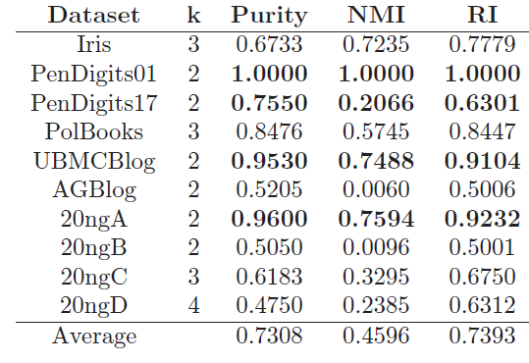
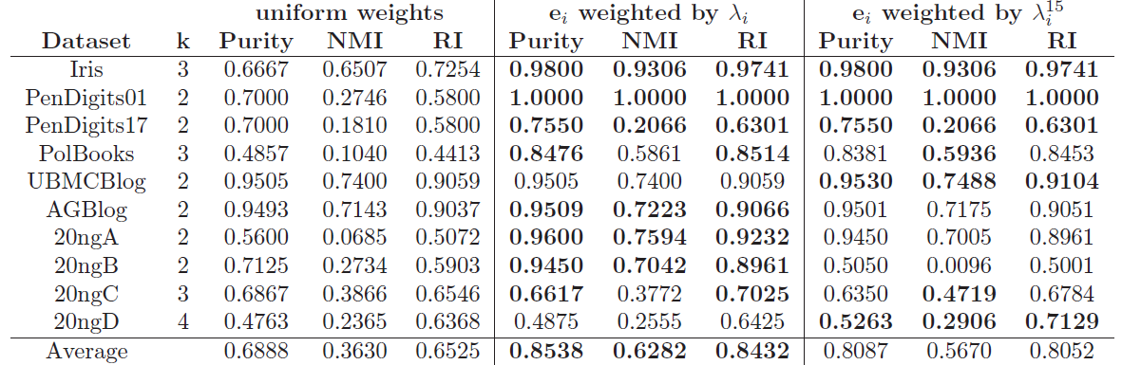
Eigenvector Weighting
Original NCut – using k eigenvectors, uniform weights on eigenvectors

Slide 98
Eigenvector Weighting
Use 10 eigenvectors, uniform weights

Slide 99
Eigenvector Weighting
Use 10 eigenvectors, weighted by respective eigenvalues

Slide 100
Eigenvector Weighting
Use 10 eigenvectors, weighted by respective eigenvalues raised to the 15th power (roughly average number of PIC iterations)

Slide 101
Eigenvector Weighting
Indiscriminant use of eigenvectors is bad – why original Normalized Cut picks k

Slide 102
Eigenvector Weighting
Eigenvalue weighed NCut does much better than the original on these datasets!

Slide 103
Eigenvector Weighting
Eigenvalue weighted NCut does much better than the original on these datasets!
Exponentially eigenvalue weighted NCut does not do as well, but still much better than original NCut

Slide 104
Eigenvector Weighting
Eigenvalue weighting seems to improve results!
However, it requires a (possibly much) greater number of eigenvectors and eigenvalues:
  More eigenvectors may mean less precise eigenvectors
  It often means more computation time is required
Eigenvector selection and weighting for spectral clustering is itself a subject of much recent study and research

Slide 105
PIC as a General Method

Slide 106
PIC as a General Method
A basic power iteration clustering algorithm:
Input: A row-normalized affinity matrix W and the number of clusters k
Output: Clusters C₁, C₂, …, C_{k}
Pick an initial vector v⁰
Repeat
  Set v^{t+1} ← Wv^{t}
  Set δ^{t+1} ← |v^{t+1} – v^{t}|
  Increment t
  Stop when |δ^{t} – δ^{t-1}| ≈ 0
Use k-means to cluster points on v^{t} and return clusters C₁, C₂, …, C_{k}

Slide 107
PIC as a General Method
W can be swapped for other graph cut criteria or similarity function
A basic power iteration clustering algorithm:
Input: A row-normalized affinity matrix W and the number of clusters k
Output: Clusters C₁, C₂, …, C_{k}
Pick an initial vector v⁰
Repeat
  Set v^{t+1} ← Wv^{t}
  Set δ^{t+1} ← |v^{t+1} – v^{t}|
  Increment t
  Stop when |δ^{t} – δ^{t-1}| ≈ 0
Use k-means to cluster points on v^{t} and return clusters C₁, C₂, …, C_{k}

Slide 108
PIC as a General Method
W can be swapped for other graph cut criteria or similarity function
Can be determined automatically at the end (e.g., G-means) since embedding does not require k
A basic power iteration clustering algorithm:
Input: A row-normalized affinity matrix W and the number of clusters k
Output: Clusters C₁, C₂, …, C_{k}
Pick an initial vector v⁰
Repeat
  Set v^{t+1} ← Wv^{t}
  Set δ^{t+1} ← |v^{t+1} – v^{t}|
  Increment t
  Stop when |δ^{t} – δ^{t-1}| ≈ 0
Use k-means to cluster points on v^{t} and return clusters C₁, C₂, …, C_{k}

Slide 109
PIC as a General Method
Different ways to pick v⁰ (random, node degree, exponential)
W can be swapped for other graph cut criteria or similarity function
Can be determined automatically at the end (e.g., G-means) since embedding does not require k
A basic power iteration clustering algorithm:
Input: A row-normalized affinity matrix W and the number of clusters k
Output: Clusters C₁, C₂, …, C_{k}
Pick an initial vector v⁰
Repeat
  Set v^{t+1} ← Wv^{t}
  Set δ^{t+1} ← |v^{t+1} – v^{t}|
  Increment t
  Stop when |δ^{t} – δ^{t-1}| ≈ 0
Use k-means to cluster points on v^{t} and return clusters C₁, C₂, …, C_{k}

Slide 110
PIC as a General Method
Different ways to pick v⁰ (random, node degree, exponential)
W can be swapped for other graph cut criteria or similarity function
Can be determined automatically at the end (e.g., G-means) since embedding does not require k
A basic power iteration clustering algorithm:
Input: A row-normalized affinity matrix W and the number of clusters k
Output: Clusters C₁, C₂, …, C_{k}
Pick an initial vector v⁰
Repeat
  Set v^{t+1} ← Wv^{t}
  Set δ^{t+1} ← |v^{t+1} – v^{t}|
  Increment t
  Stop when |δ^{t} – δ^{t-1}| ≈ 0
Use k-means to cluster points on v^{t} and return clusters C₁, C₂, …, C_{k}
Better stopping condition? Suggested: entropy, mutual information, modularity, …

Slide 111
PIC as a General Method
Different ways to pick v⁰ (random, node degree, exponential)
W can be swapped for other graph cut criteria or similarity function
Can be determined automatically at the end (e.g., G-means) since embedding does not require k
A basic power iteration clustering algorithm:
Input: A row-normalized affinity matrix W and the number of clusters k
Output: Clusters C₁, C₂, …, C_{k}
Pick an initial vector v⁰
Repeat
  Set v^{t+1} ← Wv^{t}
  Set δ^{t+1} ← |v^{t+1} – v^{t}|
  Increment t
  Stop when |δ^{t} – δ^{t-1}| ≈ 0
Use k-means to cluster points on v^{t} and return clusters C₁, C₂, …, C_{k}
Better stopping condition? Suggested: entropy, mutual information, modularity, …
Use multiple v^{t}’s from different v⁰’s for multi-dimensional embedding

Slide 112
PIC as a General Method
Different ways to pick v⁰ (random, node degree, exponential)
W can be swapped for other graph cut criteria or similarity function
Can be determined automatically at the end (e.g., G-means) since embedding does not require k
A basic power iteration clustering algorithm:
Input: A row-normalized affinity matrix W and the number of clusters k
Output: Clusters C₁, C₂, …, C_{k}
Pick an initial vector v⁰
Repeat
  Set v^{t+1} ← Wv^{t}
  Set δ^{t+1} ← |v^{t+1} – v^{t}|
  Increment t
  Stop when |δ^{t} – δ^{t-1}| ≈ 0
Use k-means to cluster points on v^{t} and return clusters C₁, C₂, …, C_{k}
Better stopping condition? Suggested: entropy, mutual information, modularity, …
Use multiple v^{t}’s from different v⁰’s for multi-dimensional embedding
Use other methods for final clustering (e.g., Gaussian mixture model)

Slide 113
PIC as a General Method
Different ways to pick v⁰ (random, node degree, exponential)
W can be swapped for other graph cut criteria or similarity function
Can be determined automatically at the end (e.g., G-means) since embedding does not require k
A basic power iteration clustering algorithm:
Input: A row-normalized affinity matrix W and the number of clusters k
Output: Clusters C₁, C₂, …, C_{k}
Pick an initial vector v⁰
Repeat
  Set v^{t+1} ← Wv^{t}
  Set δ^{t+1} ← |v^{t+1} – v^{t}|
  Increment t
  Stop when |δ^{t} – δ^{t-1}| ≈ 0
Use k-means to cluster points on v^{t} and return clusters C₁, C₂, …, C_{k}
Better stopping condition? Suggested: entropy, mutual information, modularity, …
Use multiple v^{t}’s from different v⁰’s for multi-dimensional embedding
Use other methods for final clustering (e.g., Gaussian mixture model)
Methods become fast and/or exact on a one-dimension embedding (e.g., k-means)!

Slide 114
Spectral Clustering
Things to consider:
  Choosing a similarity function
  Choosing the number of clusters k?
  Which eigenvectors should be considered “significant”?
    The top or bottom k is not always the best for k clusters, especially on noisy data (Li et al. 2007, Xiang & Gong 2008)
  Finding eigenvectors and eigenvalues of a matrix is very slow in general: O(n³)
  Construction and storage of, and operations on a dense similarity matrix could be expensive: O(n²)

Slide 115
Large Scale Considerations
But…what if the dataset is large and the similarity matrix is dense? For example, a large document collection where each data point is a term vector?
Constructing, storing, and operating on an NxN dense matrix is very inefficient in time and space.

Slide 116
Lazy computation of distances and normalizers
Recall PIC’s update is
  v^{t} = W*v^{t-1 =} = D⁻¹A * v^{t-1}
  …where D is the [diagonal] degree matrix: D=A*1
My favorite distance metric for text is length-normalized if-idf:
  Def’n: A(i,j)=<v_{i},v_{j}>/||v_{i}||*||v_{j}||
  Let N(i,i)=||v_{i}|| … and N(i,j)=0 for i!=j
  Let F(i,k)=tf-idf weight of word w_{k} in document v_{i}
  Then: A = N⁻¹FF^{T}N⁻¹

Slide 117
Large Scale Considerations
Recall PIC’s update is
  v^{t} = W * v^{t-1 =} = D⁻¹A * v^{t-1}
  …where D is the [diagonal] degree matrix: D=A*1
  Let F(i,k)=TFIDF weight of word w_{k} in document v_{i}
  Compute N(i,i)=||v_{i}|| … and N(i,j)=0 for i!=j
  Don’t compute A = N⁻¹FF^{T}N⁻¹
  Let D(i,i)= N⁻¹FF^{T}N⁻¹*1 where 1 is an all-1’s vector
    Computed as D=N⁻¹⁽F ⁽F^{T} (N⁻¹*1))) for efficiency
  New update:
    v^{t} = D⁻¹A * v^{t-1} = D⁻¹ N⁻¹FF^{T}N⁻¹ *v^{t-1}

Slide 118
Experimental results
RCV1 text classification dataset
  800k + newswire stories
  Category labels from industry vocabulary
  Took single-label documents and categories with at least 500 instances
  Result: 193,844 documents, 103 categories
Generated 100 random category pairs
  Each is all documents from two categories
  Range in size and difficulty
  Pick category 1, with m₁ examples
  Pick category 2 such that 0.5m₁<m₂<2m₁

Slide 119
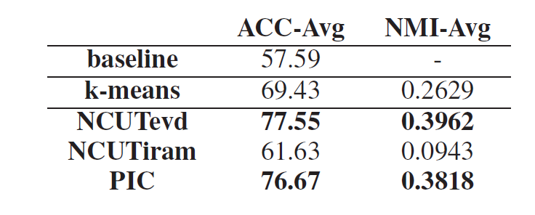
Results
NCUTevd: NCut using eigenvalue decomposition
NCUTiram: Implicit Restarted Arnoldi Method
No statistically significant difference between NCUTevd and PIC

Slide 120
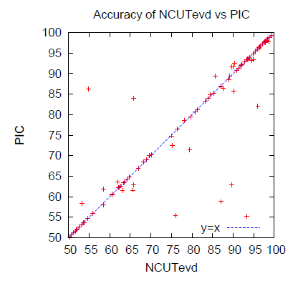
Results

Slide 121
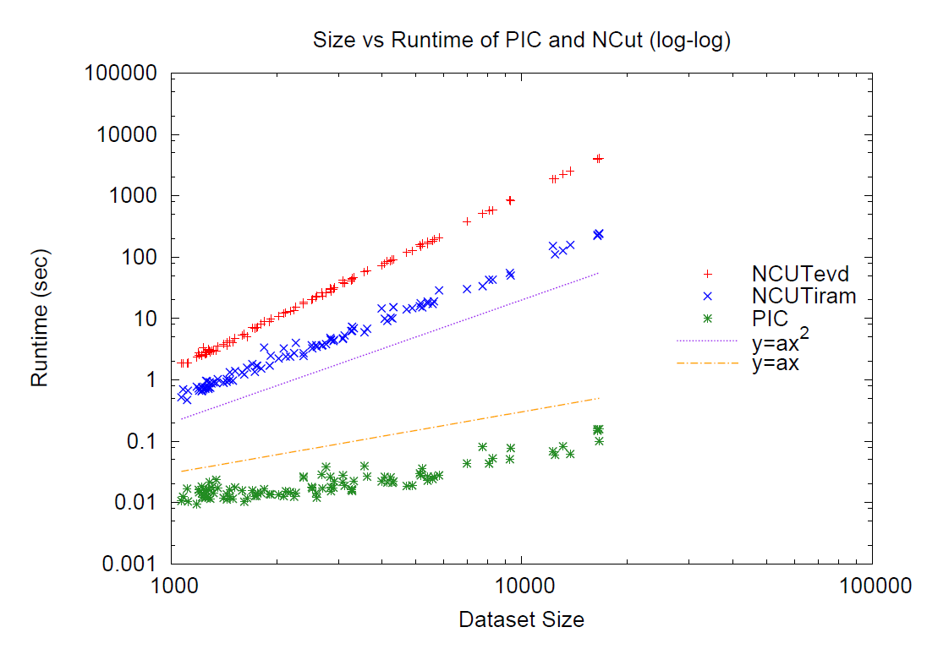
Results

Slide 122
Results
Linear run-time implies constant number of iterations.
Number of iterations to “acceleration-convergence” is hard to analyze:
  Faster than a single complete run of power iteration to convergence.
  On our datasets
    10-20 iterations is typical
    30-35 is exceptional

Slide 123
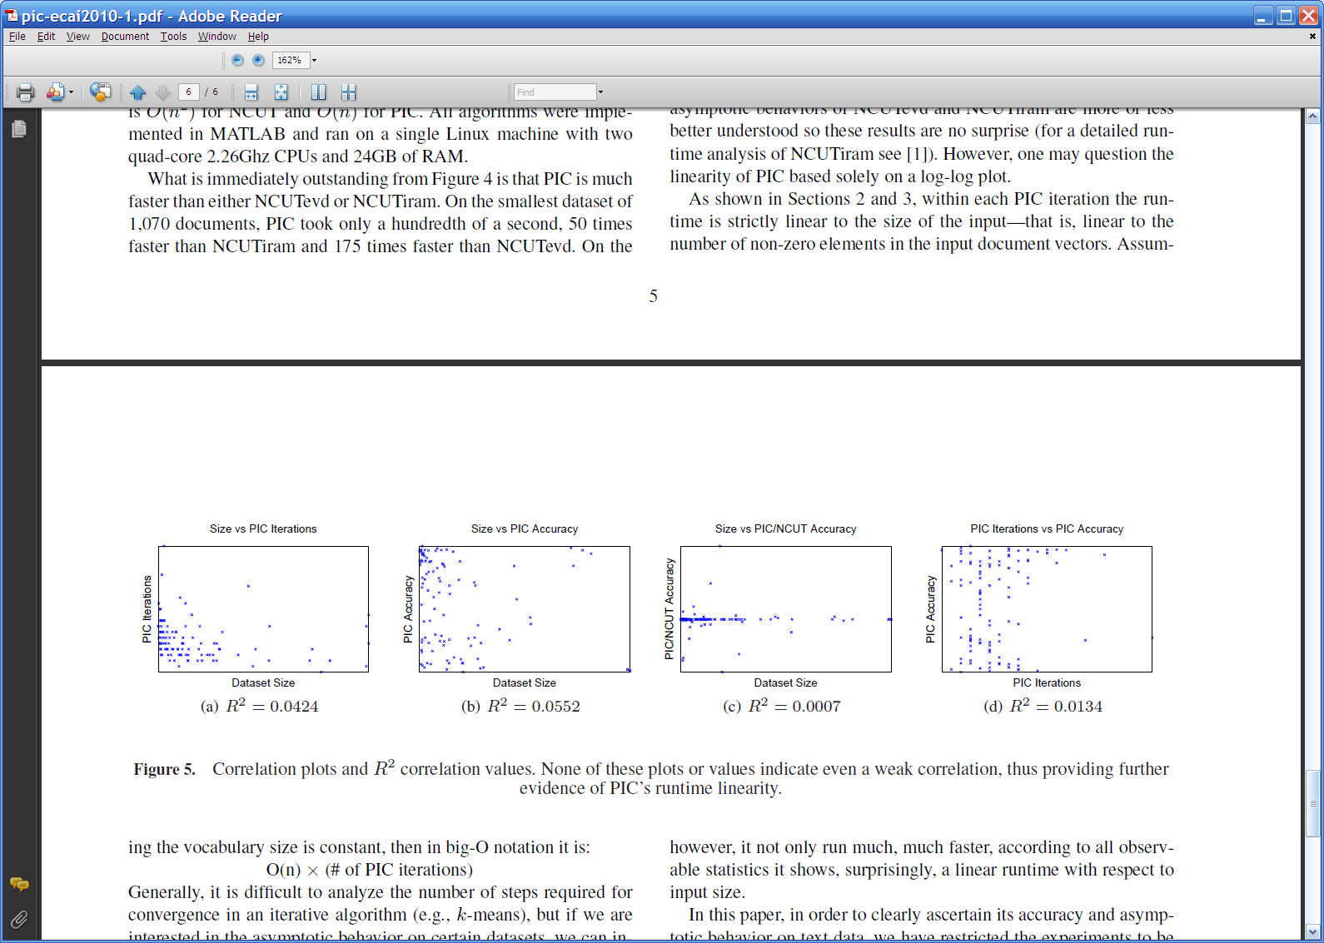
Results
Various correlation results:

